Slide 1
EpiScan GPU: A CUDA-Based Tool for Identifying Epistasis
By: Lance Hartman

Slide 2

What is Epistasis?
Epistasis can be simply defined as interaction between two different genes.
It can also be used to find SNP (single nucleotide polymorphisms) association: two or more SNPs working together to cause a phenotype.
There are two main ways that one can determine if epistasis exists between two genes or SNPs:
Physical Observation
Statistical Association
Machine Learning (feature selection/partial dependence)
Regressions
Time complexity: $O(\frac{n\left(n−1\right)}{2})$

Slide 3
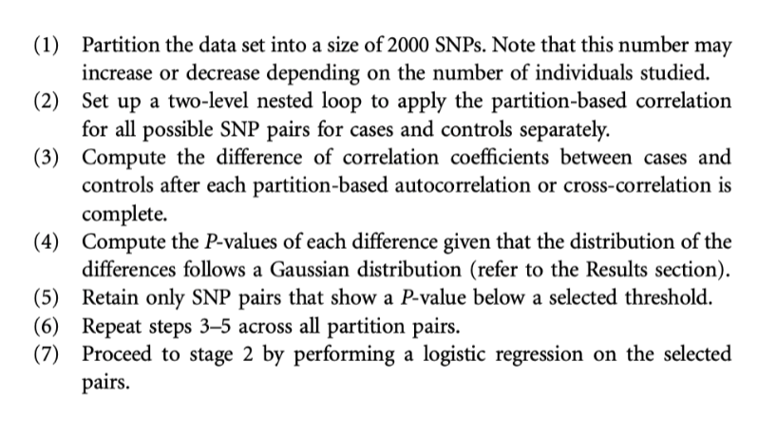
EpiScan R Package
Kam-Thong T, Czamara D, Tsuda K, Borgwardt K, Lewis CM, Erhardt-Lehmann A, Hemmer B, Rieckmann P, Daake M, Weber F, Wolf C, Ziegler A, Pütz B, Holsboer F, Schölkopf B, Müller-Myhsok B. EPIBLASTER-fast exhaustive two-locus epistasis detection strategy using graphical processing units. Eur J Hum Genet. 2011 Apr;19(4):465-71. doi: 10.1038/ejhg.2010.196. Epub 2010 Dec 8. PMID: 21150885; PMCID: PMC3060319.

Slide 4
What is CUDA?
CUDA is a set of tools provided by Nvidia that allows one to interface with their GPU through Kernel code.
CUDA can operate on Windows and Linux, compatible with the CHOP cluster.
There are CUDA libraries that operate in C, C++, C#, Python, Java, and more.
EpiScan GPU uses CUDA’s C++ toolset.

Slide 5
Pros and Cons of Working on a GPU
Pros
Designed for throughput – can complete calculations at an extremely fast speed.
GPU has its own heap memory - keeps user from using up all of their own memory.
CUDA has recently gained the ability to write to an output stream from ”within” the GPU.
Cons
Cannot use the standard libraries within CUDA code.
Dynamic memory allocation is shaky – frequent memory problems.
Sending lots of data to the GPU is the slowest part – large data analysis is tougher.
Debugging is extremely difficult.

Slide 6
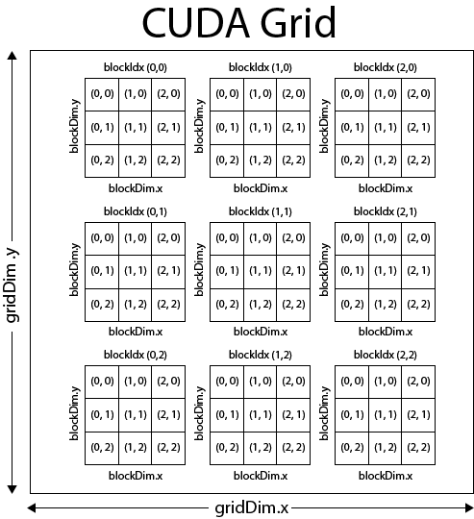
CUDA Parallelization
In addition to completing calculations faster, the design of a GPU is built on parallelization. CUDA maximizes this parallelization.

Slide 7
Using CUDA to Identify Epistasis
Orange: CPU
Blue: GPU (Parent Kernel)
Green: GPU (Child Kernel)
Purple: stdout stream
Program
Start
Data ingested into program
Memory on GPU allocated
Parent kernel starts
<<<1,1>>>
Memory is deallocated from GPU
Postprocess data
Program
Exit
Data divided into smaller chunks
Loop through each chunk of data
Loop iterates from 0 to the number of chunks, and each chunk is compared to itself and every chunk after it.
Because of this, the amount of GPU threads used per loop iteration is not constant and decreases as the program goes on.
Each iteration of the child kernel dynamically allocates a chunksize x chunksize matrix of doubles onto heap memory. Luckily, the programmer can set the heap memory to whatever is needed. This memory is deallocated within the kernel to avoid memory leaks and segfaults.
Write this information into a file
Create a child kernel
<<<1, num comparisons>>>
Find Pearson Correlation Coefficient for each SNP in chunk
*Similar workflow to the EpiScan R package described earlier.

Slide 8
Results
Compared to the R package EpiScan, results are similar. Share most entries, but GPU package has many more false positives.
Still want to compare to other proven epistasis methods as well as simulated datasets. Both of these are being tested currently (once running on the cluster).

Slide 9
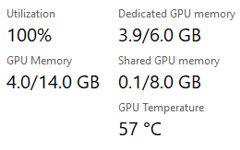
Time Improvements
Method | ALVM Data – 13562 SNPs x 711 Samples | ASD Data – 28,089 SNPs x 711 Samples
EpiScan R - | 12 min 8 sec | 51 min 29 sec
EpiScan R (Parallelized) - | 10 min 7 sec | 44 min 27 sec
EpiScan GPU - | 3 min 27 sec | 9 min 38 sec
Note* R times do not include data ingestion, GPU does

Slide 10
Potential Problems
Pearson Correlation Coefficient only identifies linear relationships between SNPs.
Maximum threads allowed in a CUDA block is 1024.
Using the standard output stream as a way to write to a file sometimes causes buffer overflow.
Data must be formatted in a very specific way.

Slide 11
For the Future
Begin considering scale of epistasis using the Maximal Information Coefficient rather than the Pearson Correlation Coefficient so that not just linear relationships but all types of relationships are taken into consideration.
1
Begin seeing capabilities on cluster – stronger GPU but Linux (runs ~10% slower). More memory on cluster GPUs than the GPU the code has been tested on.
3
Start running on larger datasets.
4
Make sure that the math is correct and more accurately verify that epistasis is being predicted.
2
Make more user friendly – instead of adding multiple constants, allow user to manipulate code through command line flags.
5

Slide 12
Sources
Original EpiScan R package can be found here: https://github.com/cran/episcan
My parallelized version of the EpiScan R package can be found here: https://github.com/LanceGuy5/episcan-parallelized
The source code for EpiScan GPU can be found here: https://github.com/LanceGuy5/EpiScan-gpu

